Slide 1
Petrochemical industry
Rob Hendrickson, MD

Slide 2
Objectives
Process
Clinical effects
  Acute/subacute toxicity
  Chronic toxicity
Mitigation, monitoring, and safety

Slide 3
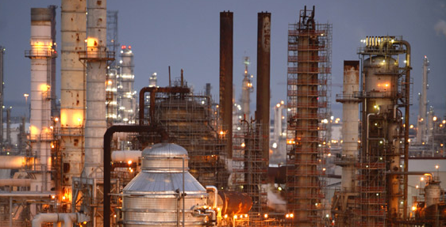
Petroleum refining

Slide 4
Petroleum refining
Conversion of crude oil to usable products
Crude oil = ‘crude petroleum’
  Organic matter
    Converted via bacteria & low temp chemical reactions to kerogen (complex solid w HMW molecules)
    Converted to bitumen (complex HWM hydrocarbons; e.g. tars)
    Converted to liquid petroleum (HMW hydrocarbons [C15-40] with high sulfur content)
    Under higher pressure and temperature, converted to LMW hydrocarbons (C<15) with less sulfur

Slide 5
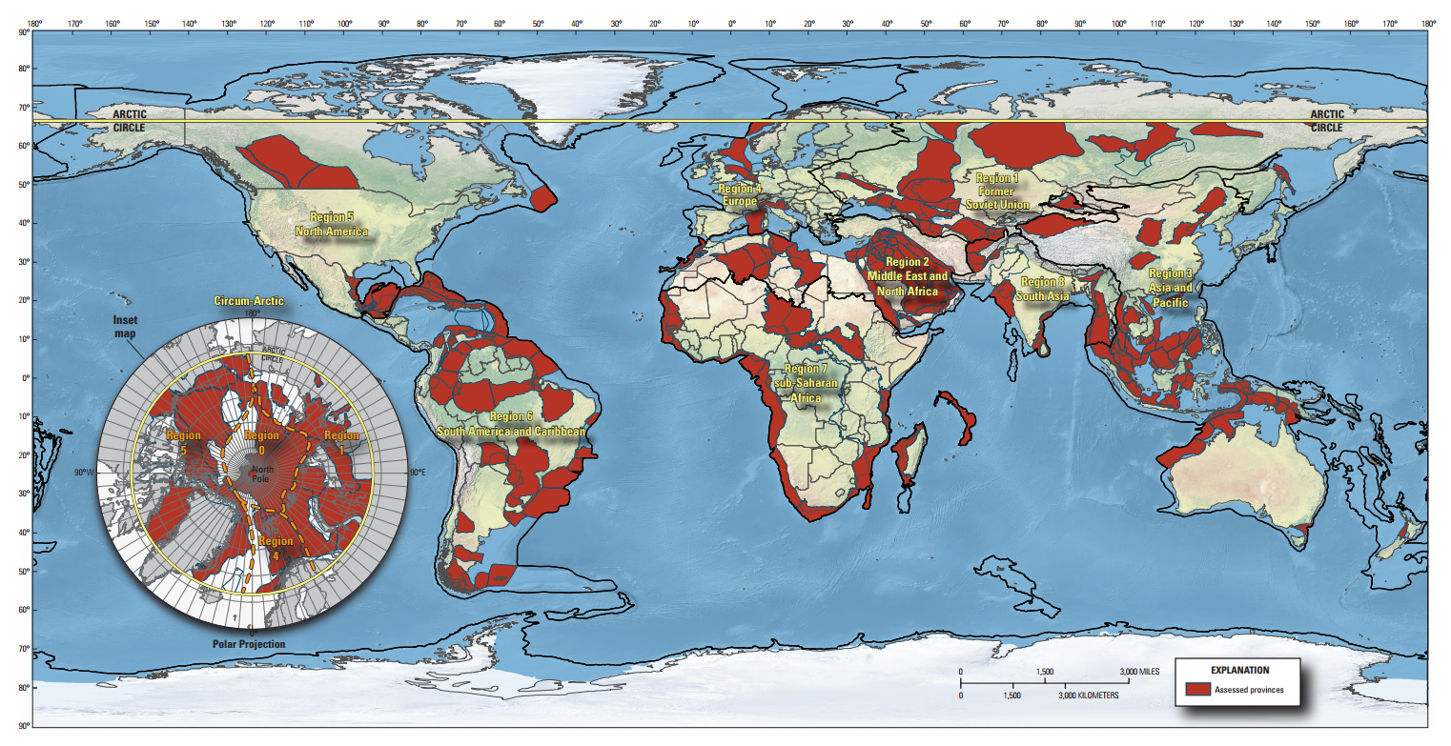
Notes:
Gulf of Thailand

Slide 6
Crude Oil
Crude oil
  Significant variability of content throughout the world
    84-87% carbon
    11-14% hydrogen
    0-3% sulfur
    0.2% nitrogen
    0.2-7% Polycyclic aromatic hydrocarbons
    0.01-1% Benzene

Slide 7
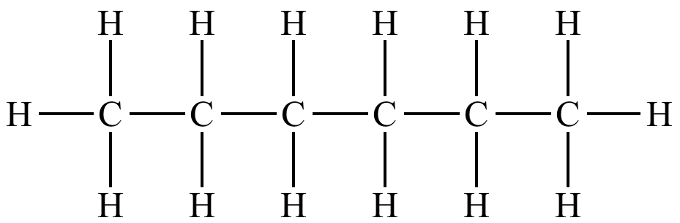
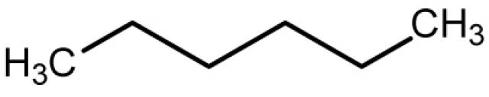
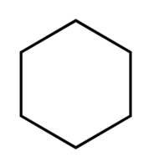
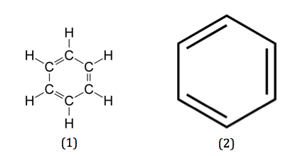
Crude Oil
Crude oil
  Combination of many hydrocarbons (C1-50)
    Aliphatic/paraffin compounds
      saturated hydrocarbons
    Naphthene compounds
      Saturated cyclic hydrocarbons
    Aromatic compounds
      Cyclic hydrocarbons with alternating single and double bonds
Notes:
Aliphatic – saturated hydrocarbon (no double bonds). May be straight or cyclic.
Naphthene – saturated and cyclic. Cyclohexane is the example above.
Aromatic – cyclic with alternating double and single bonds.

Slide 8
Crude Oil
Crude oil
  ‘Sweet crude’ – low sulfur
    < 5 ppm hydrogen sulfide
  ‘Sour crude’ – high sulfur
    > 5 ppm hydrogen sulfide (sometimes up to 100,000 ppm)
  Paraffinic base – large [] of straight hydrocarbons
  Naphthenic base – large [] of saturated rings with side chains
  Aromatic base – large [] of aromatics

Slide 9
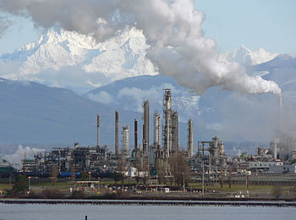
Petroleum refining
Separation of hydrocarbons – by carbon length
  Distillation
  Cracking
  Reforming

Slide 10
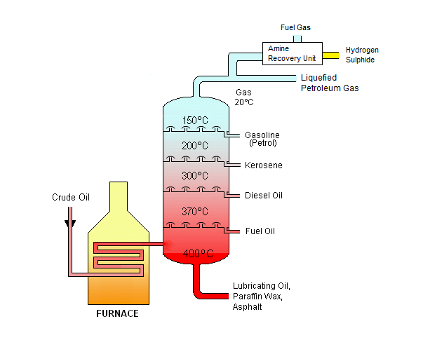
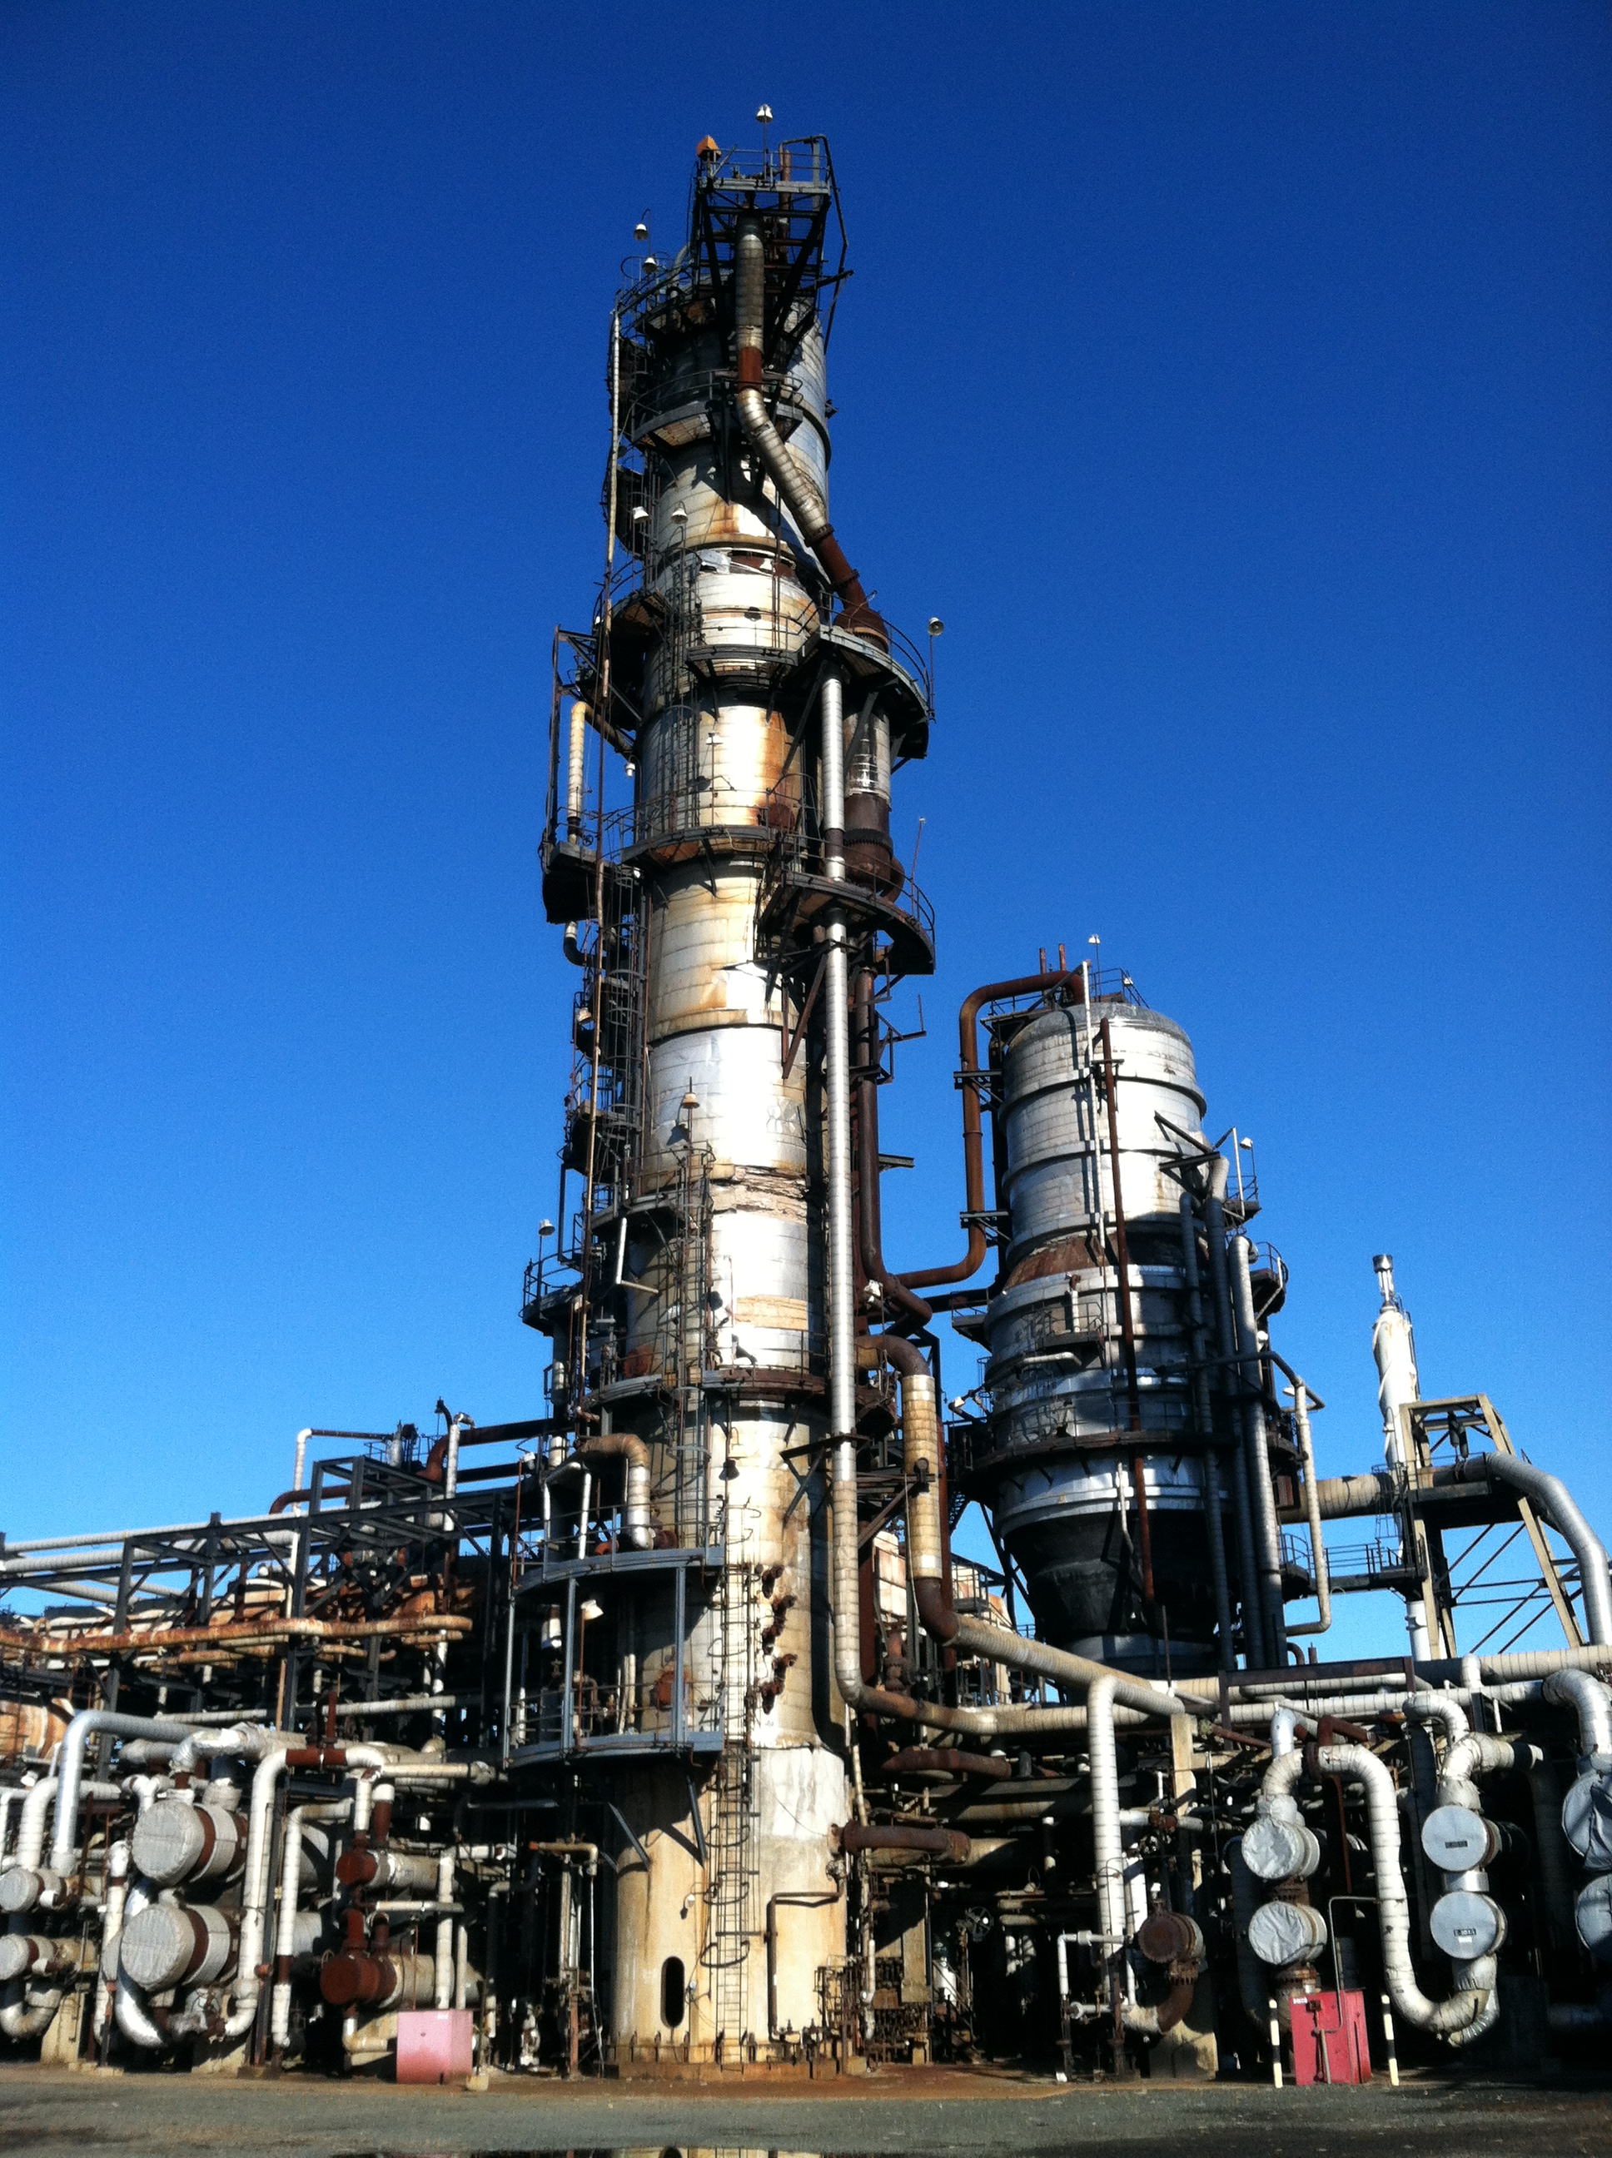
Fractionated distillation

Slide 11
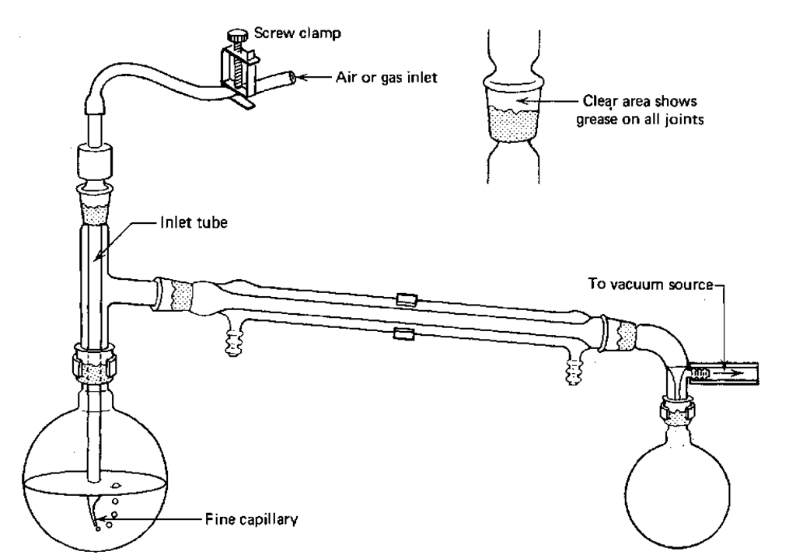
Vacuum distillation
Distillation
Additional distillation to separate the heavier hydrocarbons
  Heavier hydrocarbons have higher boiling points
  These high temperatures would cause degradation of molecules (“cracking”), so distillation is performed in a vacuum to lower boiling temperature
Notes:
Water boils at 88C at 11,000 feet.

Slide 12
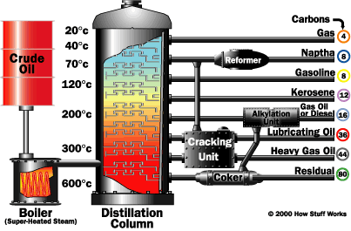
Distillation

Slide 13
Cracking
Distillation
Heat and catalysts to break down (“crack”) large molecules into smaller molecules
  Thermal cracking (high pressure)
  Catalytic cracking (“cat cracking”)
    Zeolite = aluminum & silicon
  Steam cracking (brief, high temp, no oxygen)
  Hydrocracking (hydrogen)
Generally used to produce gasoline (petrol), with carbon chains of 5-10

Slide 14
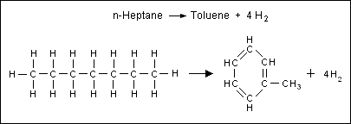
Reforming
Converting straight hydrocarbons to branched hydrocarbons or aromatics (can be used for increasing octane in gasoline)
  Platinum catalyst

Slide 15
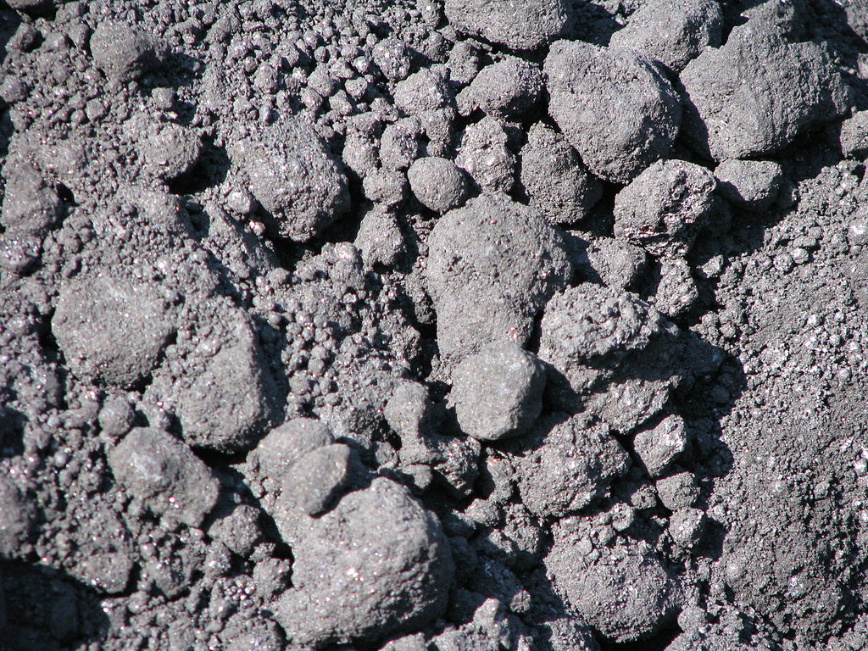
Coking
Catalytic and thermal separation of heavy residue oil
Results in separation of lighter oils and leaves “coke”
  Coke = 95% carbon
    Used for:
      heating (smokeless burning)
      Production of electrodes
        aluminum and steel industries

Slide 16
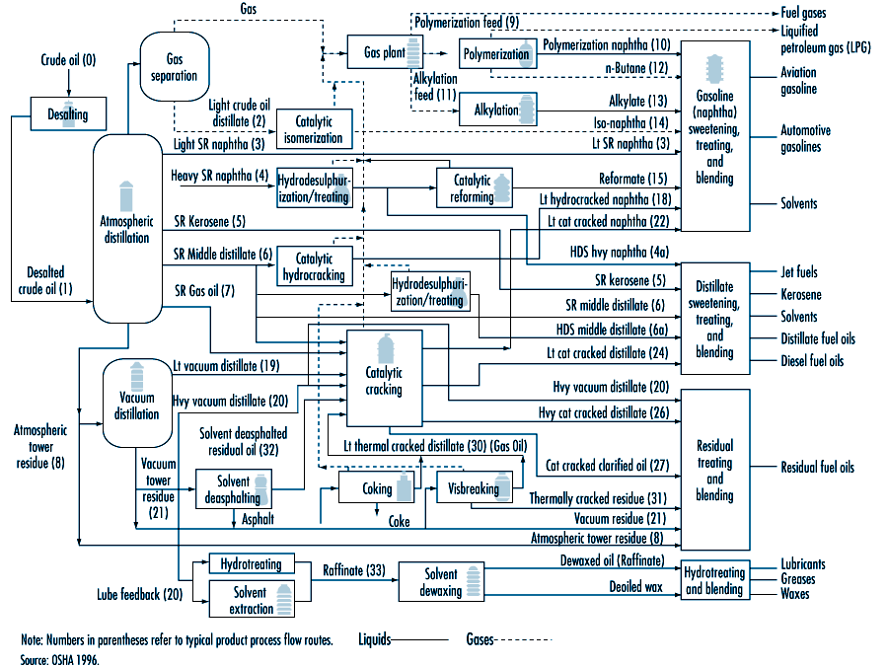
Petrochemicals

Slide 17
Clinical toxicities

Slide 18
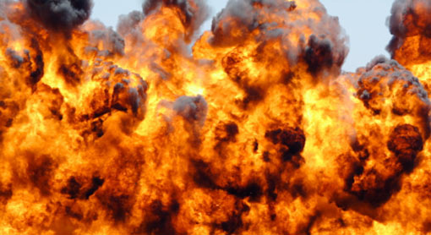
Acute/subacute
Acute event of greatest concern = explosion and fire

Slide 19
Acute/subacute
Acute toxicities
  CNS effects:
    Hydrocarbons
    Carbon monoxide (CO)
    Hydrogen Sulfide (H₂S)
  Mucosal and dermal irritation

Slide 20
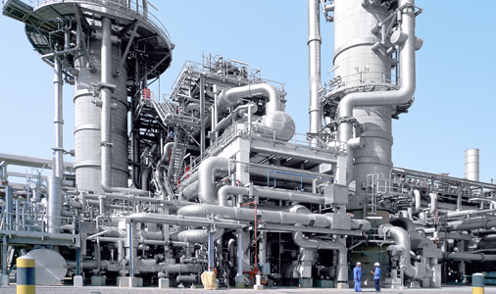
CNS depressants
Closed systems
Detectors
PPE

Slide 21
Hydrocarbons
Short carbon chain hydrocarbons
  Inhalational route
  Carbon chains 3-10 in length
    E.G. propane, butane, pentane, hexane, etc
  CNS depression
  Simple asphyxiants
Result of releases, leaks, fugitive emissions
  low [] of hydrocarbon in refinery air

Slide 22
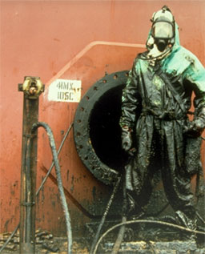
Hydrocarbons
Treatment:
  Removal from exposure
Mitigation:
  Avoid exposure!
    Enclosed space processes
    Monitoring
    Enclosed systems

Slide 23
Carbon monoxide
Colorless, odorless – poor warning properties
Symptoms:
  Mild: Headache, nausea/vomiting, confusion
  Severe: Cardiac & Neurologic toxicity
Mechanism
  Binds to hemoglobin & myoglobin
  Inhibits oxidative phosphorylation
  Displaces NO
Notes:
CO causes hemoglobin to hold O2 closer and not deliver O2 to the tissues. (left shift of the oxy-hgb dissociation curve)

Slide 24
Carbon monoxide
Treatment:
  Removal from exposure
  Oxygen
  Hyperbaric oxygen
Mitigation:
  Engineering controls
  Detectors

Slide 25
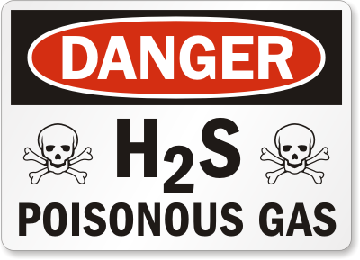
Hydrogen Sulfide
Moderately water soluble irritant gas
  Mild, delayed mucosal irritation
Systemic effects
  Inhibiting oxidative phosphorylation
    “cyanide-like” effects – inhibition of cytochrome aa3
    “knock down”
    Multi-organ failure
    Multiple casualties

Slide 26
Hydrogen Sulfide
Poor warning properties
  Potent smell of rotten eggs
  Olfactory fatigue – smell less at stable []
  Olfactory paralysis – less odor at higher []

Slide 27
Hydrogen Sulfide
Concentration dependent effects:
  0.02ppm “rotten egg” odor
  50ppm MM irritation, N/V/D
  100ppm sweet smell
  150ppm no odor. + ataxia, lightheadedness, ALI
  500ppm loss of consciousness (seconds)
    Respiratory paralysis, asphyxia

Slide 28
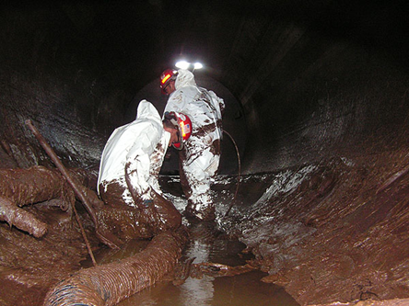
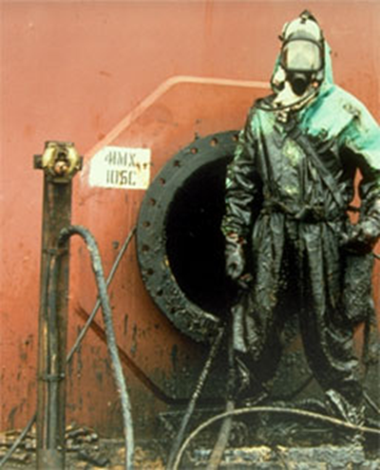
Hydrogen Sulfide
Exposure due to:
  spill/release
  Enclosed space

Slide 29
Hydrogen Sulfide
Treatment
  Oxygen
  ??? Nitrites – probably not effective
  ? HBO – elevates dissolved oxygen
    May increase diffusion of oxygen to marginally perfused tissue
    May decrease H2S binding to cytochrome oxidase
Notes:
Nitrites: – produce methemoglobin which binds to H2S to form sulfmethemoglobin which is metabolized by rhodanase

Slide 30
Subacute
Dermatitis/irritant/skin sensitizers
  MTBE (additive in gasoline)
  H₂S
  Cutting oils
  Aminated alkylaryl polyether compounds
  Alkylaryl sulfonate compounds
  Ethylene diamine
  Alkylamines

Slide 31
Chronic
Cancer risk
  Epidemiologic studies
    Mixed
    Suggest that there is no increased risk of cancer in petroleum refinery workers
  Handling known human carcinogens
    Benzene
    PAHs, benzo[a]pyrene

Slide 32
Benzene
Contained in crude oil and finished products (e.g. gasoline)
  IARC 1 known human carcinogen
    Acute myelogenous leukemia
  Found in very low quantities in vapor

Slide 33
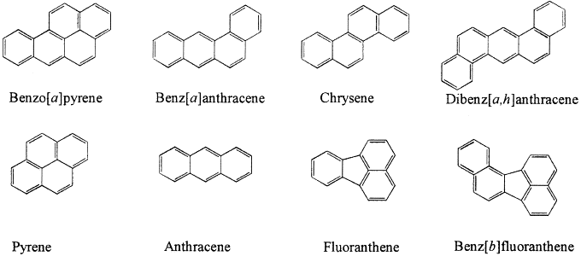
PAHs
Polycyclic aromatic hydrocarbons
  Organic compounds with >=3 aromatic rings
    Most carcinogenic PAHs have 5 or 6 rings
Notes:
Benzo[a]pyrene, dibenz[a,c]anthracene, chrysene, 1-nitropyrene

Slide 34
PAHs
Polycyclic aromatic hydrocarbons
  Found in crude oil and in middle and heavy distillate fraction
    Exposures: cracking, coking, and asphalt processing
      Mostly to lighter, 2-3 aromatic ring PAHs that have little to no carcinogenicity
  Inhalation or dermal absorption
Notes:
Benzo[a]pyrene, dibenz[a,c]anthracene, chrysene, 1-nitropyrene

Slide 35
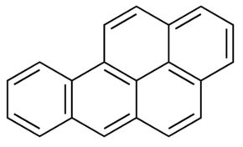
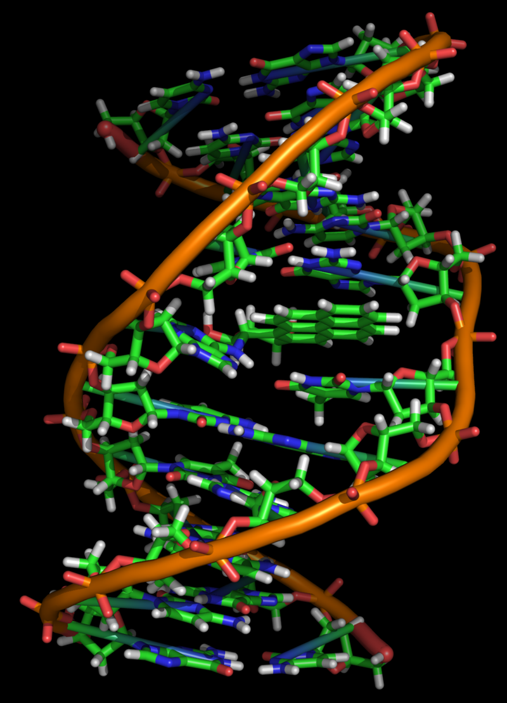
PAHs
Benzo[a]pyrene
  IARC 1 carcinogen
  Primary carcinogen responsible for:
    Lung cancer from cigarette smoke
    Scrotal cancer in chimney sweeps (1800s)
  Procarcinogen – CYP1A1
    benzo[a]pyrene-7,8-dihydrodiol-9,10-epoxide
Notes:
Benzo[a]pyrene, dibenz[a,c]anthracene, chrysene, 1-nitropyrene
BaP is metabolized by CYP1A1 to epoxide via a 3 step process. The “ultimate carcinogen” = bap-7,8-dihydrodiol-9,10-epoxide

Slide 36
Protection of workers
Engineering controls
  Closed systems
Airborne monitoring
  CO, H₂S
Periodic exam and questionnaire
  Inhaled irritants
  Dermal sensitizers
Notes:
Biomonitoring – total urine (end of shift) phenols for benzene;

Slide 37


Questions and discussion…

